Slide 1
Top Five For Small Business:
EX.O.T.I.C. Legal Issues for Employers
An EXplanation Of Terms and Issues of COVID-19 Legal Issues for Employers
Brent L. Hinders
Hugh J. Cain
Eric M. Updegraff
August 26, 2020

Slide 2
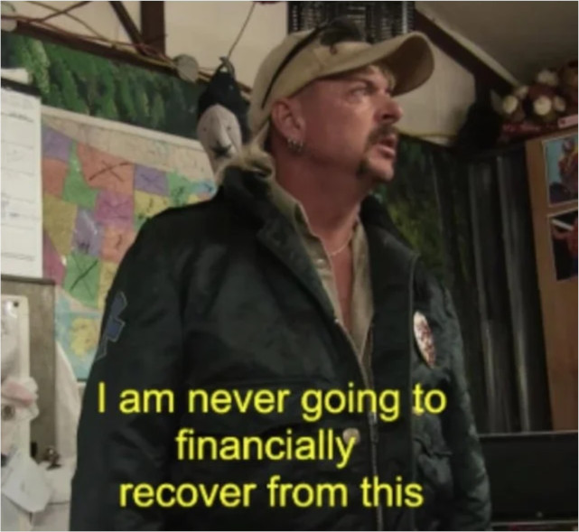
Tiger King: Murder, Mayhem, and Madness (March 20, 2020)
A Documentary series centered on the life of Joseph Maldonado-Passage, A/K/A Joe Exotic, a former police officer, Tiger Breeder, Musician, and Politician from Wynnewood, OK.
Exotic is currently serving a 22-year federal prison sentence for animal abuse and murder for hire of Big Cat Rescue CEO, Carole Baskin.
Released on March 20, 2020, by Netflix, it was watched by 34.3 Million people during the first 10 days of release, partially due to the Coronavirus pandemic

Slide 3
The Families First Coronavirus Recovery Act (“FFCRA”)
Signed into law on March 14, 2020. Went into effect on April 1, 2020.
Several Provisions to help with funding and economic recovery in the final law
Employer Provisions
  Expanded Paid Sick Leave Act (“EPSLA”)
  Emergency Family Medical Leave Act (“EFMLA”)
    Effective until December 31, 2020
    Most Private Employers and Public Employers with fewer than 500 employees are subject to the law.

Slide 4
Expanded Family Medical Leave Act EFMLA
Expanded FMLA (EFMLA). Unlike the prior version of the FMLA, this applies to all employers with under 500 employees, not simply those with more than 50 employees.
Any employee who has worked for you for 30 days is eligible for this FMLA expansion.
§ 3101 (Amends Family Medical Leave Act, 29 USC 2611 et seq)

Slide 5
Reason for Leave
    An employee can take 12 weeks of EFMLA leave due to COVID-19 emergency for these reasons:
      Care for son or daughter under 18 whose school or care place closed;
      Childcare provider is unavailable.
      These are the only reasons for EFMLA leave

Slide 6
Amount of Leave
This leave is paid, again unlike the prior version of the FMLA. The employer pays as follows:
  For the first 10 days employer pays $0. May be effected by EPSLA.
  Thereafter, employer pays not less than 2/3s of the employee’s regular rate and the number of hours normally scheduled to work but capped at $200 a day or $10,000 in aggregate.

Slide 7

United States Toilet Paper Shortage/ Hoarding
(Circa, March 2020-May 2020)
Concerns about the Pandemic in March to May, 2020, dramatically increased Toilet Paper sales throughout the United States.
Toilet Paper Sales overall increased 845% and Toilet Paper rose from the 30th highest-selling grocery product to #1 in early March 2020.
Paper towel sales also increased by 536% in the same time period.
While there were regional shortages due to shipping issues, there was never a risk of running out of toilet paper in the U.S.

Slide 8
EPSLA – Sick Leave Expansion
Emergency Paid Sick Leave Act (EPSLA) leave is in addition to any current leave that employers currently provide.
Employers can not make an employee take the current available employer provided leave first. § 5101(d)(2)(B)
EPSLA applies to any employee (even if they just started yesterday). § 5102(d)(1)

Slide 9
6 Conditions Where EPSLA Applies
The employee is subject to quarantine order;
A health care provider has advised the employee to self-quarantine;
The employee experiences symptoms of COVID-19 and is seeking medical diagnosis;
The employee is caring for someone who has been advised or ordered to quarantine;
The employee is caring for son-daughter whose school has closed or childcare provider has become unavailable due to COVID-19;
The employee is experiencing other substantially similar condition specified by Secretary of Health and Human Services.
§ 5101

Slide 10
Amount of EPSLA
Conditions 1 – 3, pay regular rate – cap of $511/day or $5,110 total.
Conditions 4 – 6, pay 2/3s of regular rate – cap of $200/day or $2,000 aggregate
§ 5110(5)

Slide 11
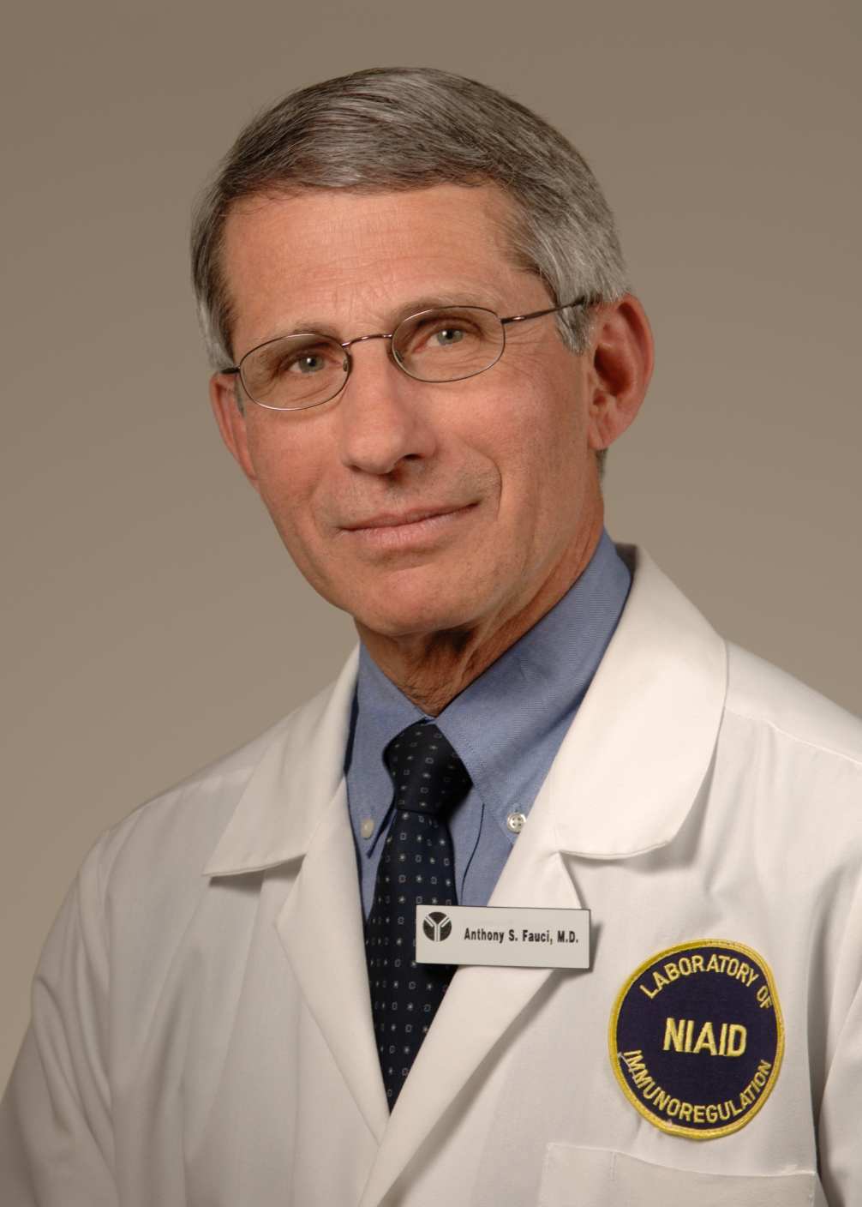
Dr. Anthony Fauci – Director, NIAID, member of Coronavirus Task Force
Dr. Fauci is a physician and immunologist who has been the Director of the U.S. National Institute of Allergy and Infectious Diseases since 1984.
Dr. Fauci has been an advisor to every U.S. President since Ronald Reagan
Dr. Fauci was awarded the National Medal of Science in 2007 by George W. Bush
Dr. Fauci was the spokesperson for the Coronavirus Task Force for a period of time beginning in January 2020.

Slide 12
Temperature Scans
EEOC says temperature scans are medical exams under ADA, 42 USC § 12112(d), but can be administered if job related and consistent with business necessity. EEOC Technical Assistance Guidance, Questions and Answers, Last Updated May 7, 2020.
Government likely to have “police power” to require temperature scan. State v. Hartog, 440 N.W. 2d 852 (Iowa 1989), In re Rutledge, 956 F3d 1018 (8th Cir. 2020)
However, CDC guidelines important
Schools not expected to do such screenings
If screenings are done, then very explicit regulations.

Slide 13
Exclusion of Health Care Providers and Emergency Responders
On April 1, 2020, the Department of Labor issued regulations, including who are “health care providers” and “emergency responders” who can be excluded from coverage from EPSLA and EFMLA.
29 CFR § 826.30

Slide 14
Health Care Provider
A “healthcare provider” is anyone employed at any doctor’s office, hospital, healthcare center, clinic, post-secondary educational institution offering health care instruction, medical school, local health department or agency, nursing facility, retirement facility, nursing home, home health care provider, any facility that performs laboratory or medical testing, pharmacy, or any similar institution employer or entity. 29 CFR § 826.30(c)(1)
Much broader than FMLA definition of “healthcare provider.” 29 USC § 2611(6), 29 CFR 825.102

Slide 15
Emergency Responder
29 CFR § 826.30(c)(2)
An “emergency responder” is military or national guard, law enforcement officers, correctional institution personnel, fire fighters, emergency medical services personnel, physicians, nurses, public health personnel, emergency medical technicians, paramedics, emergency management personnel, 911 operators, public works personnel, and persons with skills or training in operating specialized equipment or other skills need to provide aid in a declared emergency as well as individuals who work for such facilities employing these individuals and whose work is necessary to maintain the operation of the facility.

Slide 16
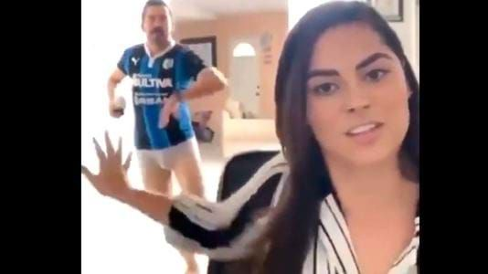
“Zoom” Meetings
Videoconferencing software rose to prominence in March - April 2020 when its downloads increased 30 times over the previous year.
Biggest selling point was free, 40 minute conference calls with up to 100 attendees.
The platform was used for such activities as: business meetings, in-home schooling, “virtual” happy hours, and family reunions.
Several problems with the platform such as “Zoom bombing” and the occasional naked participant/ bystander.

Slide 17
COVID-19 and Medical Information
For screening purposes, Employers can only ask questions on COVID-19 related symptoms of current or prospective employees (post-offer pre-employment medical examination).
Employers must maintain all information about employee illness as a confidential medical record (including temperature measurement), but may disclose that information to a public health agency.
Employers can send home employees with symptoms and require a Doctor’s note and/or proof of a negative test prior to allowing the employee back in to the workplace.

Slide 18
COVID-19 and Reasonable Accommodation
If a job can only be performed in the workplace:
  Reasonable accommodations should be given to individuals whose disability (physical or mental) puts him or her at greater risk from COVID-19 to eliminate possible exposure. Recognized Accommodations: One way aisles, plexiglass, barriers to ensure minimum distance between customers and coworkers.
  Accommodations may be temporary in nature (which should be documented) to the time of the COVID-19 pandemic, and may include job restructuring of marginal duties, transfer to other positions, modifying a work schedule or shift assignment.

Slide 19
COVID-19 and the Interactive Process
The need for an accommodation may be made by the employee at the time or based on a known pre-existing condition.
If there is urgency in an accommodation, during the pandemic, the employer may shorten, eliminate, or otherwise adapt the interactive process based on the situation and requested accommodation
Short term accommodations based on COVID-19 should be documented, limited in time, and extended or changed based on government guidance.
Accommodations may be extended for the future based on the circumstances.
The Employer may request medical information to document the request for an accommodation.
There may be a need to adapt a pre-existing accommodation based on work conditions or telework.

Slide 20
COVID-19 and Undue Hardship to the Employer to Provide an Accommodation
An Employer may deny an accommodation if it creates a “significant difficulty or expense.”
  “Significant Difficulty” – determined by situations dictated by current government regulations imposed by COVID-19 safety precautions.
  “Significant Expense” – determined by current budget and resources which may be reduced due to loss of income streams.
An Employer may not consider different accommodations and standards for “Critical Personnel” or “Essential Workers.”

Slide 21
COVID-19 and the Workplace
Employers may require employees to wear protective gear (masks, gloves, etc.) and observe infection control practices (social distancing, hand washing, etc.) in the workplace.
Employers may require precautionary measures for teleworking employees.
The Employer may not restrict employees from the physical workplace due to his or her age, but may restrict employees from the workplace due to a disability accommodation.

Slide 22
COVID-19 and Family Accommodations
Work Accommodations are only for an Employee’s Disability and NOT for family member’s disability.
Employers may make accommodations for telework, modified schedules or other means to help employees with school-aged children but can not give one gender more favorable treatment than another.
Employers may not involuntarily exclude pregnant employees from the workplace.

Slide 23

Delivery and carry-out mixed drinks and food
In Iowa, Carryout Mixed Drinks were authorized via a Gubernatorial Proclamation in March 2020.
In March 2020, Restaurant attendance decreased by 22%, but delivery orders increased by 67%.
Door Dash constituted 67% of third party delivery sales in the U.S.
Legislation was passed in June 2020, to make Carryout Alcohol a permanent fixture in Iowa.

Slide 24
COVID-19 And Workers’ Compensation
There are two possible basis for compensability under Iowa’s Workers Compensation Act.
  COVID-19 as “Accident” – Under Iowa Code Chapter 85, the actual risk doctrine states that if the nature of the employment exposes the employee to the risk of such an injury it is compensable. It makes no difference that the risk was common to the general public. Lakeside Casino v. Blue, 743 N.W. 2d 169 (Iowa 2007)
  2) COVID-19 as “Occupational Disease” – Under Chapter 85A, the disease must have a direct causal connection with the employment and followed as a natural incident from the injurious exposure occasioned by the nature of the employment. A disease that follows from a hazard the employee was equally exposed outside of their work is not compensable as an occupational disease.

Slide 25
Re-Opening Immunity under SF 2338
*Would be Codified at Iowa Code Chapter 686D
No civil action alleging exposure to COVID-19 unless one of these:
Minimum medical condition – death or hospitalization,
Act intended to do harm, or
Act constitutes actual malice.

Slide 26
COVID-19 Premises Liability
Person controlling premise who invites or permits individual onto premise, not liable for civil damages for injuries due to exposure of COVID-19 unless:
Recklessly disregards substantial and unnecessary risk that individual exposed to COVID-19;
Exposes individual though malice, or
Intentionally exposes individual to COVID-19.

Slide 27
Safe Harbor
Person not liable for civil damages if act was in substantial compliance with state or federal statutes, regulation, order, or public health guidance.
“Public health guidance” include
CDC
Center for Medicare/Medicaid
OSHA
Office of Governor
Any state agency, including Department of Public Health

Slide 28
OSHA – General Duty Standard
“Each employer shall furnish…a place of employment which is free from recognized hazards that are causing or are likely to cause death or serious injury.”
Iowa Code § 88.4

Slide 29

Hamilton
A sung/rapped-through musical that tells a story based on the life of American Founding Father Alexander Hamilton.
Originally premiering off Broadway in February 2015, this multiple Tony winner written by Lin Manuel Miranda was described by Miranda as “America then, as told by America Now.”
The Disney Plus movie version featured the original Broadway cast and was recorded in 2015-2016.
It’s premiere on Disney Plus on July 3, 2020, increased downloads 72.4% on D+.

Slide 30
Best Practice Recommendations for when the Pandemic Ends.
Comply with existing OSHA, CDC, and other local workplace safety or health organization regulations for safety protocols.
Meet with employees to determine which disability accommodations need to remain.
Adapt the workplace, job duties, work schedules, budgets, and employee needs for potential future pandemic outbreaks.
Appreciate employees and the resilience required for each individual to live, and work, through unprecedented challenges.

